Slide 1


NEXT GEN EMPLOYABILITY PROGRAM
CREATING A FUTURE-READY WORKFORCE

Slide 2
Student Name : SIDDI LAKSHMI PRIYANKA
Student ID : STU63b42b43ee5a91672751939
College Name :Velagapudi Ramakrishna Siddhartha College

Slide 3
CAPSTONE PROJECT SHOWCASE
Project Title : Healthcare prediction on diabetic patient using python
Abstract | Problem Statement | Project Overview | Proposed Solution | Technology Used | Modelling & Results | Conclusion | Q&A

Slide 4
Abstract
The increasing prevalence of diabetes worldwide necessitates the development of effective healthcare management strategies. This project proposes a predictive analytics solution using Python to forecast potential health risks and optimize patient care for individuals with diabetes. The system leverages machine learning algorithms on comprehensive patient datasets to predict future health outcomes, enabling timely intervention and personalized healthcare strategies.The project encompasses data preprocessing, feature engineering, and the implementation of advanced machine learning models for accurate prediction. Key health indicators such as blood glucose levels, BMI, and medical history are considered to build a robust predictive model. The system's architecture integrates Python libraries such as scikit-learn and pandas, ensuring scalability, efficiency, and accuracy in prediction.The developed solution aims to empower healthcare professionals with actionable insights into patient health trajectories, facilitating proactive decision-making and resource allocation. Additionally, it provides diabetic patients with personalized risk assessments, enabling them to actively engage in their healthcare journey. The project's outcomes are expected to contribute to the enhancement of diabetes management practices, leading to improved patient outcomes and overall healthcare system efficiency.

Slide 5
Problem Statement
Diabetes, a prevalent and chronic health condition, demands a proactive and personalized approach to management to mitigate associated risks and complications effectively. The existing healthcare system often faces challenges in predicting and preventing adverse health outcomes for diabetic patients. Consequently, there is a pressing need for an advanced predictive analytics solution to empower healthcare professionals and patients with timely insights, facilitating a shift from reactive to proactive diabetic care.

Slide 6
Project Overview
Objective:
To develop a Python-based predictive analytics solution for efficient diabetic patient management.
Methodology:
Data preprocessing, feature engineering, and machine learning model implementation using Python libraries.
Technology Stack:
Utilize Python, scikit-learn and pandas for efficient data processing and modeling.
Expected Outcomes:
Accurate prediction of future health risks.
Improved resource allocation and patient engagement.
Conclusion:
We build the model using some machine learning algorithms such as Random Forest, Logistic regression, Decision tree, Support vector machines(SVM) and KNN. These all are supervised machine learning algorithms.

Slide 7
Proposed Solution
1. DATA COLLECTION
2.EDA
3. FEATURE ENGINEERING
4. DATA MODELLING
5. EVALUATION
6. GUI

Slide 8
Our proposed system aims at Predicting the number of Diabetes patients and eliminating the risks of False Negatives Drastically.
In the proposed system we use Random forest, Decision tree, Logistic regression,SVM and KNN classifier to classify the patients who are affected by diabetes or not.
Random forest and decision tree are the algorithms which can be used for both classification and regression.
The dataset is classified into trained and test dataset where the data can be trained individually, these algorithms are very easy to implement as well as very efficient in producing better results and can be able to process large amount of data.
Even for the large dataset these algorithms are extremely fast and can be able to give good accuracy.
Training is the most important part, where we train our model using the data available and make the machine learn and understand data
When the model has learned from the data, we provide the model with another dataset to evaluate how good our model is performing, if it is performing well, we can then test the model using the test data, where we get to know the final performance of our model, which can be measure using various metrics, such as accuracy, recall, precision, and through classification report.

Slide 9
Technology Used
Programming Language:
Python: Widely used for machine learning and data analysis tasks. Python offers various libraries and frameworks suitable for building predictive models, such as scikit-learn, TensorFlow, and pandas.
Machine Learning Libraries:
scikit-learn: A versatile machine learning library in Python, offering tools for data preprocessing, model training, and evaluation.
Data Processing and Analysis:
pandas: A powerful data manipulation and analysis library in Python.
NumPy: Essential for numerical operations in Python.
Data Visualization:
Matplotlib and Seaborn: Popular Python libraries for creating visualizations and graphs.
GUI:
Tkinter: Standard GUI (Graphical User Interface) library in Python. It provides tools for creating windows, buttons, labels, and other GUI components.
Click here
Reference link

Slide 10
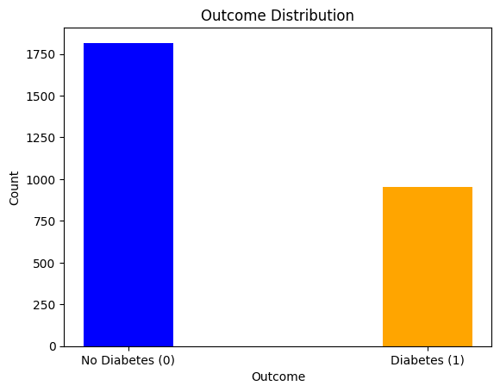
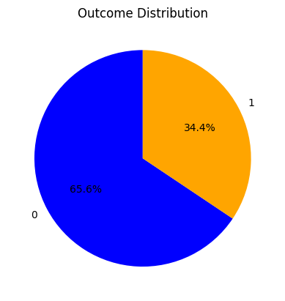
Outcome variable:

Slide 11
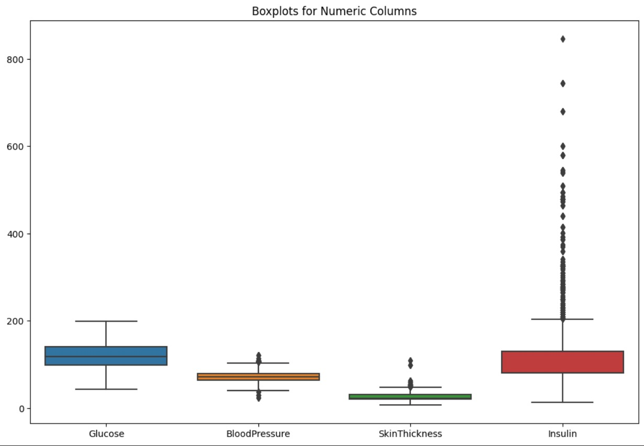
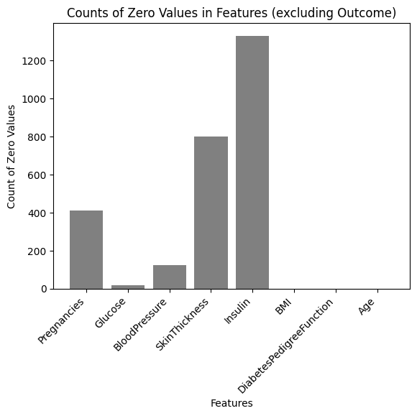

Slide 12
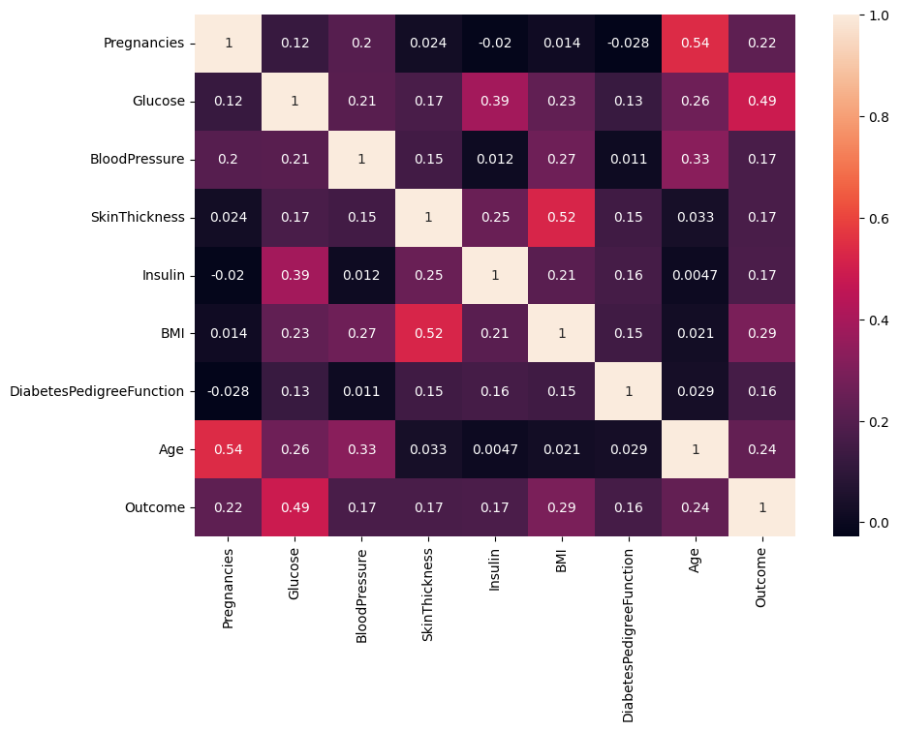
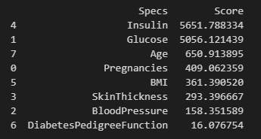
Correlation Matrix:
Best Features:

Slide 13
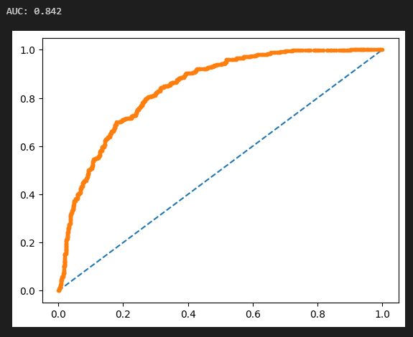
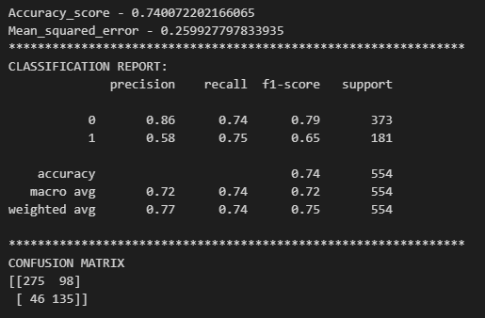
Logistic Regression:

Slide 14
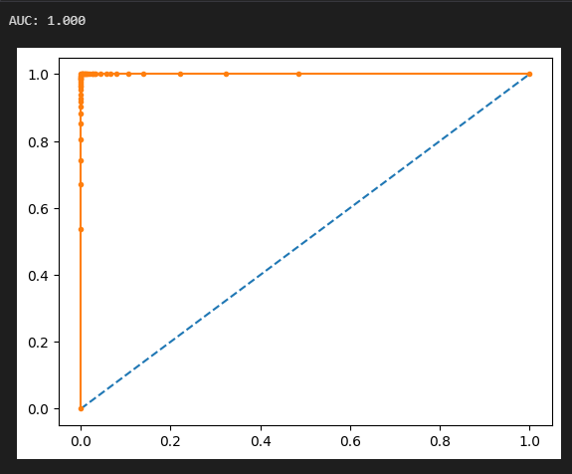
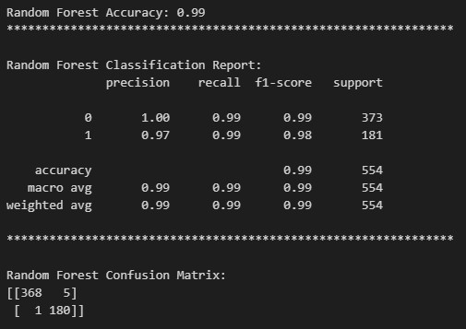
Random Forest:

Slide 15
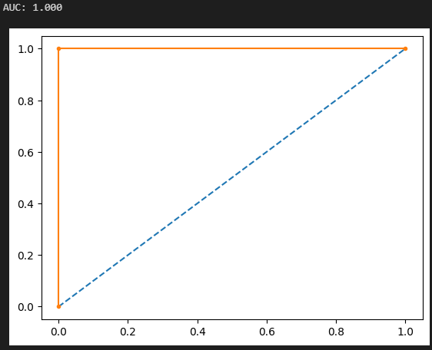
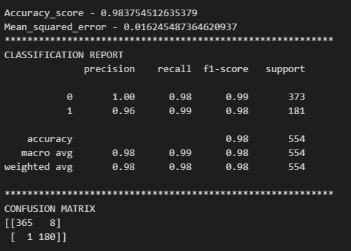
Decision Tree:

Slide 16

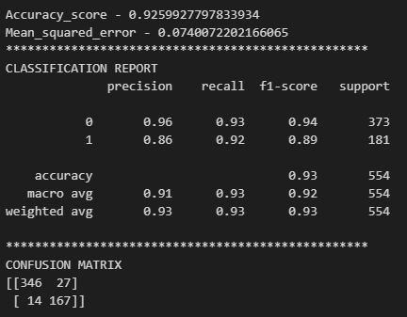
KNN:

Slide 17
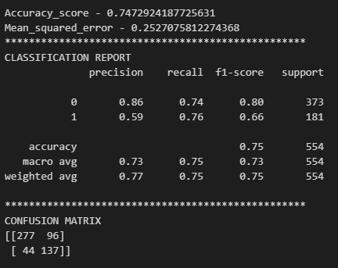
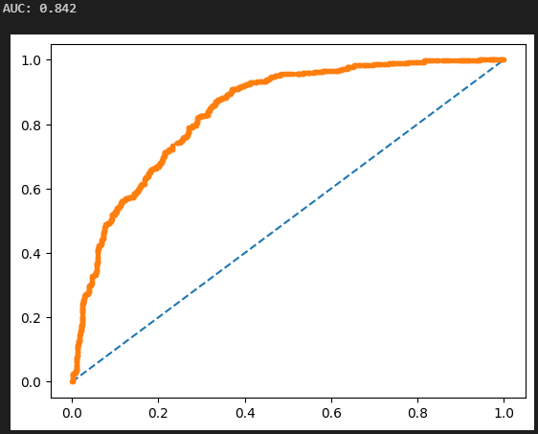
SVM:

Slide 18
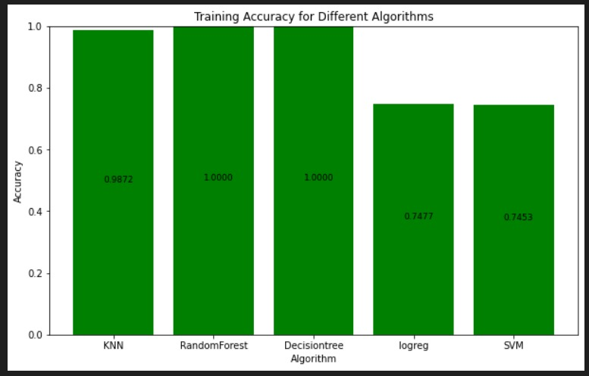
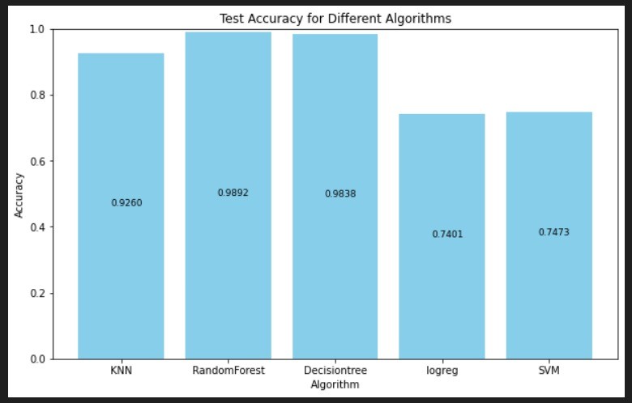
Train Accuracy:
Test Accuracy:

Slide 19
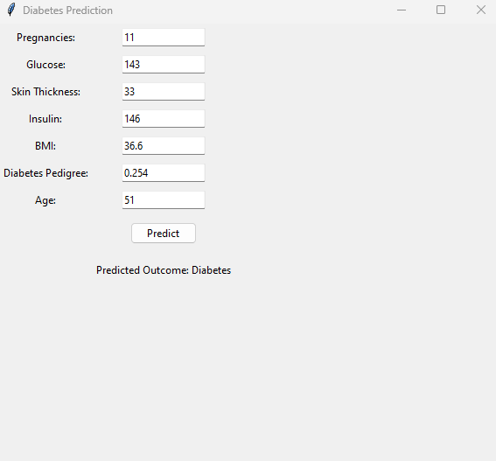
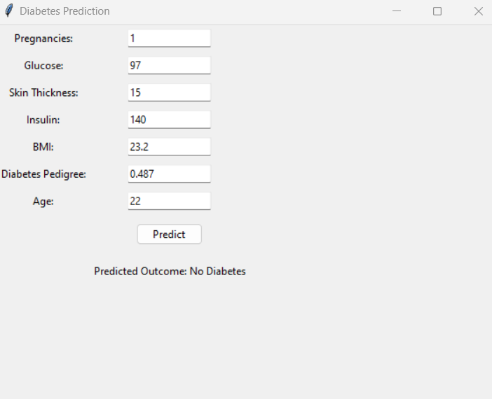
GUI Screenshots:

Slide 20
Conclusion
As per the main objective of this project is to classify and identify Diabetes Patients using ML algorithms is being discussed throughout this project.
we build the model using some machine learning algorithms such as Random Forest, logistic regression, decision tree , KNN and SVM these all are supervised machine learning algorithms.
As part of the future scope, we hope to try out different algorithms and extend it into deep learning to optimize the feature output process, increase the feature similarity of data to improve the model’s representation capability.

Slide 21
Thank You!
Notes:
Thank You !!

